Slide 1


Python Functions
Making Code Simple, Reusable, and Organized
Presented by:
Amit Roy
MSc Student at IIT

Slide 2
The Basics
What are functions and why should we use them?

Slide 3

THE FUNCTION MACHINE
What is a Function?
Think of a function as a Kitchen Blender. You give it ingredients (Inputs), it performs a specific task (Mixing), and it gives you a smoothie (Output).
Instead of manually chopping fruit every time, you just press the "Blender" button.
Reusable blocks of code
Performs one specific task
Makes code easier to read

Slide 4
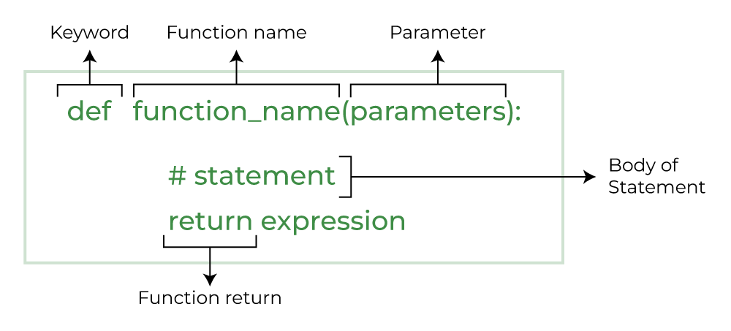
STRUCTURE OF A FUNCTION
def keyword Used to define a function.
Function Name The name (identifier) used to call the function.
Parameters (Optional) Variables inside parentheses that receive input values.
Colon (:) Indicates the beginning of the function body.
Function Body An indented block of code that executes when the function is called.
return Statement (Optional) Sends a value back to the caller.

Slide 5
Example (Like 8.2, 8.3)
def greet():
print("Hello! Welcome to the class.")
greet()
Hello! Welcome to the class.
Output
Function Parameters (Like 8.4)
# Function with a single parameter
def greet(name):
print("Hello", name)
# Calling the function and passing “Amit" as the argument
greet(“Amit")
Output
Hello Alice

Slide 6
Function Multiple Parameters (Like 8.4)
# Function with multiple parameters
def add_numbers(a, b):
print("The sum is:", a + b)
# Passing two numbers to the function
add_numbers(10, 5)
The sum is: 15
Output
Default Parameter (Like 8.6)
# Setting "Guest" as the default value for the 'name' parameter
def greet(name="Guest"):
print("Welcome,", name)
# Python uses the default "Guest")
greet()
# Calling with an argument (Overrides the default value)
greet("Amit")
Output
Welcome, Guest
Welcome, Amit

Slide 7
Return Statement (Like 8.5)
def scquare(x):
return x * x
result = scquare(5)
print("The square of 5 is:", result)
The square of 5 is: 25
Output
Returning Multiple Values
def get_marks():
x = 10
y = 20
return x, y
result = get_marks() print (result)
print (result[0])
print (result[1])
Output
(10, 20)
10
20

Slide 9
Returning Values as a Dictionary
Using a Dictionary as Function Parameter
def get_person_info():
return {
"name": "Alice",
"age": 30,
"city": "New York"
}
info = get_person_info()
print (info["name"])
print(info["age"])
print(info["city"])
def print_user_info(user):
print(f"Name: {user['name']}")
print(f"Age: {user['age']}")
print(f"City: {user.get('city', 'Unknown')}")
user_data = {"name": "Bob", "age": 25}
print_user_info (user_data)
Output
Name: Bob
Age: 25
City: Unknown
Output
Amit
90
Dhaka

Slide 10
Keyword Arguments (Like 8.10)
Output
I have a dog named Buddy.
def describe_pet(name, animal):
print(f"I have a {animal} named {name}.")
describe_pet (animal="dog", name="Buddy")
Variable Length Arguments (Like 8.11)
Output
def print_numbers(*args):
for num in args:
print(num)
print_numbers(1, 2, 3, 4)
1
2
3
4
def print_info( ** kwargs):
for key, value in kwargs.items():
print(f"{key}: {value}")
print_info(name="Amit", age=60)
Output
name: Amit
age: 60

Slide 11
Use Docstrings (triple quotes """) to explain what your function does so others can use it easily.
Docstring
def greet (name):
""" Print a greeting to the given name."""
print (f"Hello, {name}!")
greet("Amit")
help(greet)
"Code is read much more often than it is written."
Output
Hello, Amit!
Help on function greet in module __main__:
greet(name)
Print a greeting to the given name.
— Guido van Rossum (Creator of Python)

Slide 12
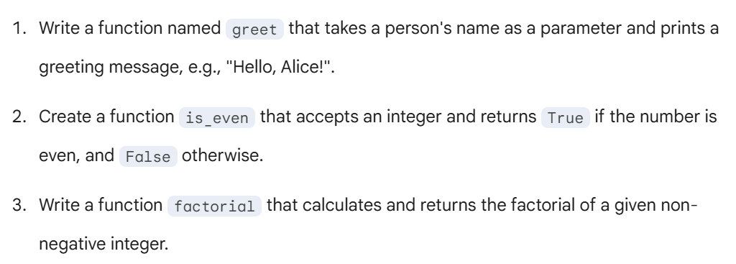
Practice Problem

Slide 13
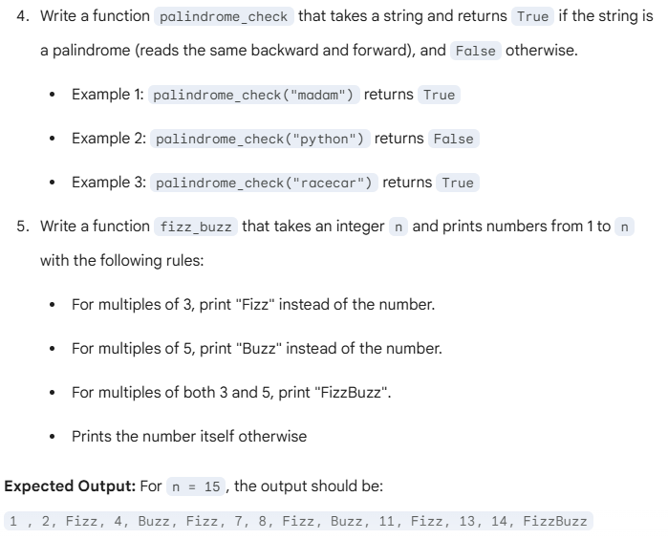
Practice Problem

Slide 14

Questions?
You are now ready to build your own Python functions!
Happy Coding

